Slide 2
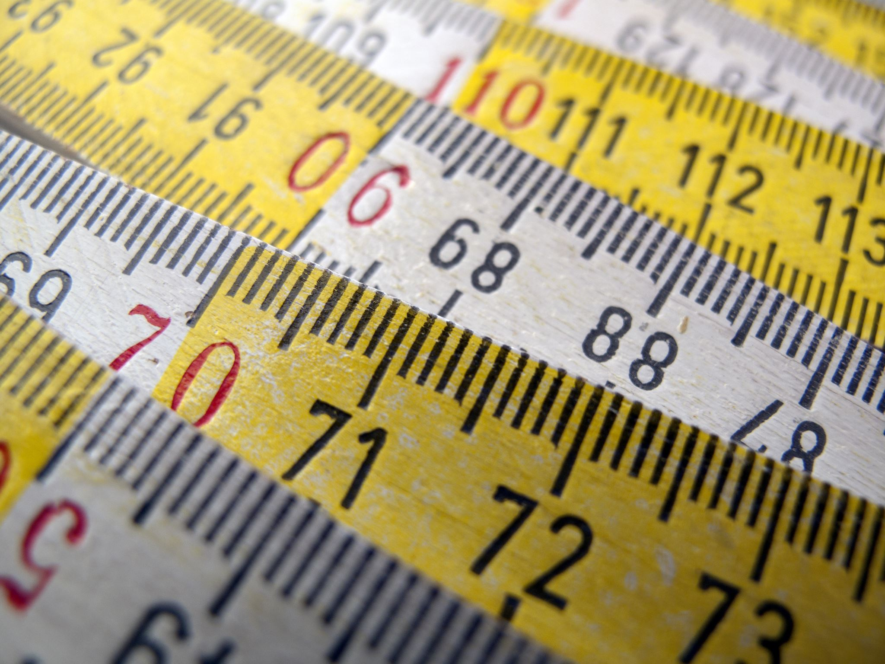
Determining Units

Slide 3
dRESP
dRESPmsr
DO temp correction
mg
28.06mL
dRESP
animal
L
1
oxySol function wql package
Actual Do mg/L
Vial Volume

Slide 4
dRESP
dRESPmsr
DO temp correction
mg
28.06mL
dRESPmsr $ oxygen
dRESP
animal
L
1
oxySol function wql package
Actual Do mg/L
Vial Volume

Slide 5
dRESP
dRESPmsr
DO temp correction
mg
.02806L
dRESPmsr $ oxygen
dRESP
animal
L
1
mg
oxySol function wql package
Actual Do mg/L
Vial Volume

Slide 6
dRESP
dRESPmsr
DO temp correction
mg
.02806L
dRESPmsr $ oxygen
dRESPmsr $ oxygen
1000
dRESP
animal
L
1
mg
µg
oxySol function wql package
Actual Do mg/L
Vial Volume

Slide 7
dRESP
dRESPmsr
DO temp correction
mg
.02806L
dRESPmsr $ oxygen
dRESPmsr $ oxygen
1000
dRESP
animal
L
1
mg
µg
oxySol function wql package
Actual Do mg/L
Vial Volume

Slide 8
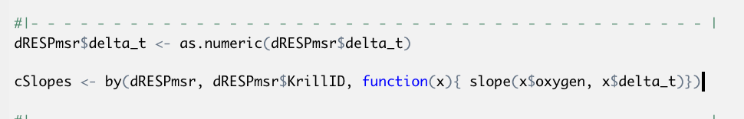
dRESP
dRESPmsr
DO temp correction
mg
.02806L
dRESPmsr $ oxygen
dRESPmsr $ oxygen
µg
cSlopes
(correction via) Blank Mean values (per trial)
Corrected Slope Values
Corrected Slope Values
Final slope values
1000
µg/min
µg/min
dRESP
animal
L
1
.00 minutes
Animal Wet Weight
mg
µg
µg/min
mg
1000
Animal Wet Weight
µg oxygen/min
µg
Slope function
µg Krill Tissue
oxySol function wql package
Actual Do mg/L
Vial Volume
dSlopes$WetWeightSlope <- dSlopes$CorrSlope/dSlopes$WetWeight

Slide 9
dRESP
dRESPmsr
DO temp correction
mg
.02806L
dRESPmsr $ oxygen
dRESPmsr $ oxygen
µg
cSlopes
(correction via) Blank Mean values (per trial)
Corrected Slope Values
Corrected Slope Values
Final slope values
1000
µg/min
µg/min
dRESP
animal
L
1
.00 minutes
Animal Wet Weight
mg
µg
µg/min
mg
1000
Animal Wet Weight
µg oxygen/min
µg
Slope function
µg Krill Tissue
oxySol function wql package
Actual Do mg/L
Vial Volume
dSlopes$WetWeightSlope <- dSlopes$CorrSlope/dSlopes$WetWeight

Slide 10
dRESPmsr $ oxygen
µg
cSlopes
(correction via) Blank Mean values (per trial)
Corrected Slope Values
Corrected Slope Values
Final slope values
µg/min
µg/min
.00 minutes
Animal Wet Weight
Animal Wet Weight
µg
µg/min
mg
1000
µg oxygen/min
µg
Slope function
µg Krill Tissue

Slide 11
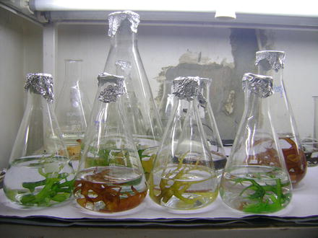
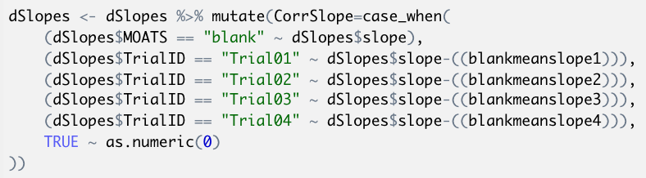
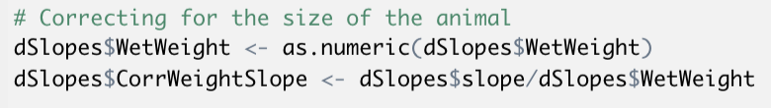
cSlopes
(correction via) Blank Mean values (per trial)
Corrected Slope Values
Corrected Slope Values
Final slope values
µg/min
µg/min
Animal Wet Weight
Animal Wet Weight
µg oxygen/min
µg/min
mg
1000
g
g Krill Tissue

Slide 12
dRESP
dRESPmsr
dRESP
animal

Slide 13
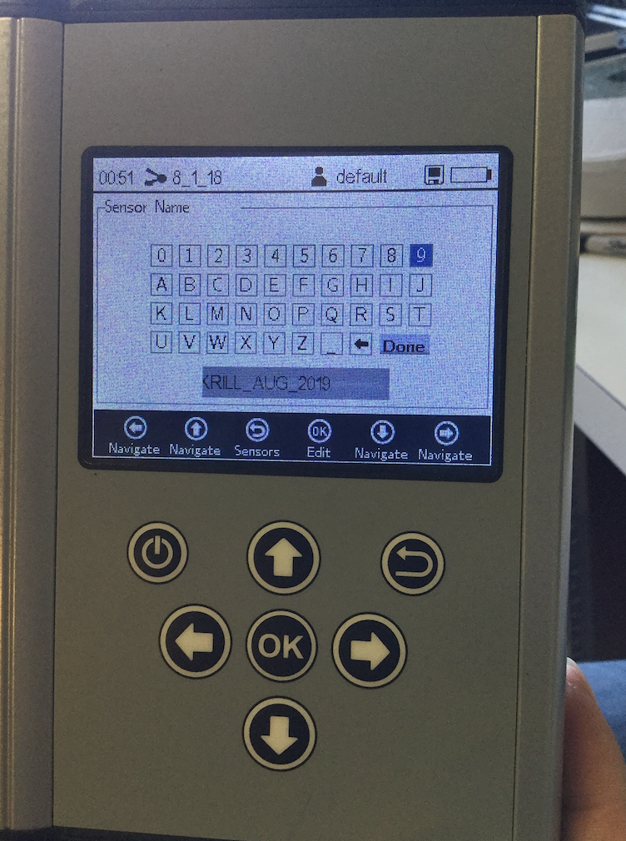
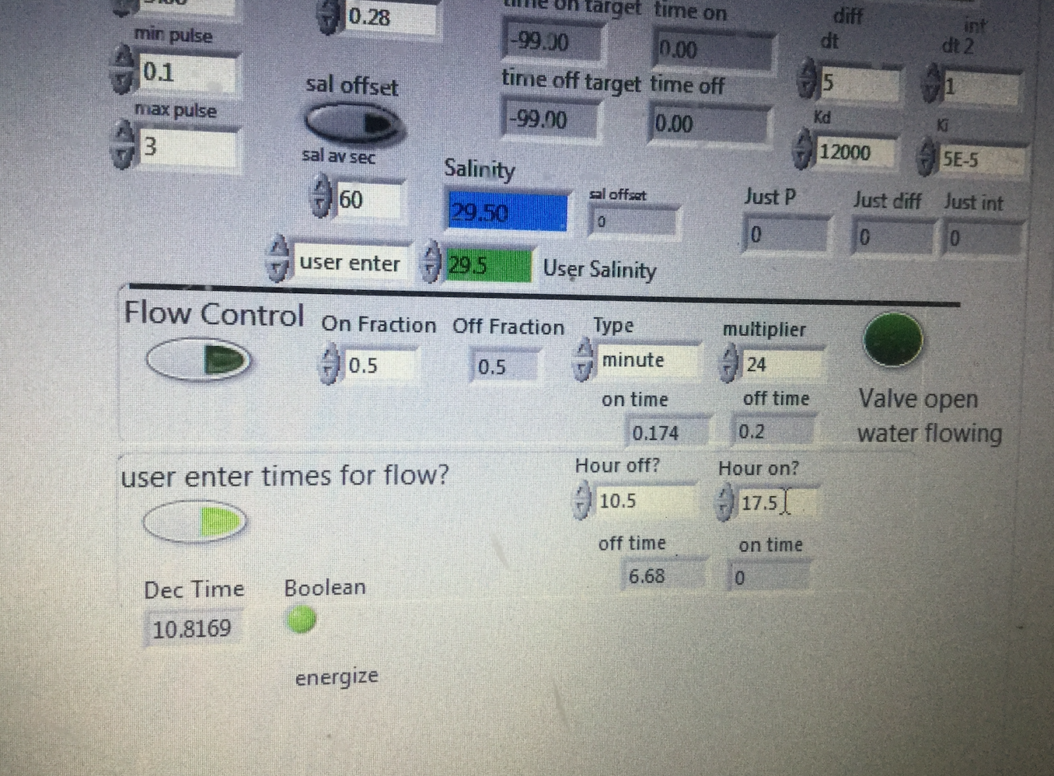

Slide 14
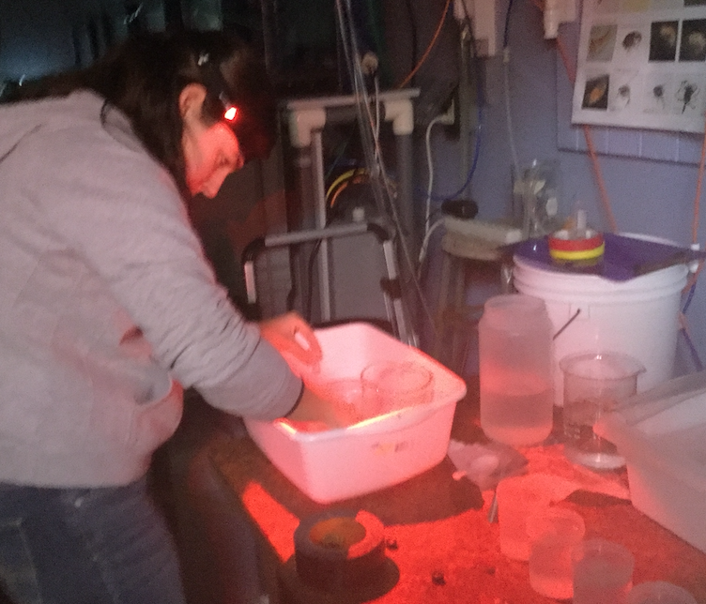
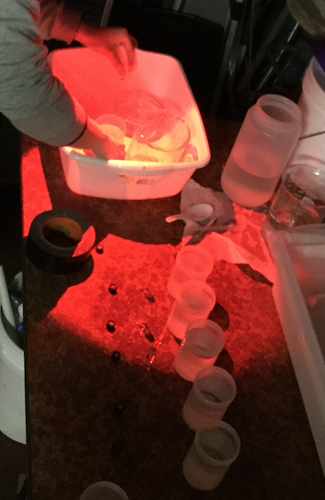
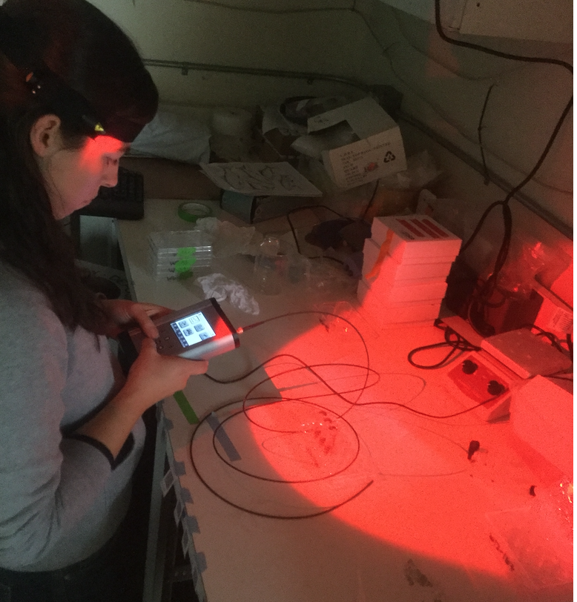

Slide 15
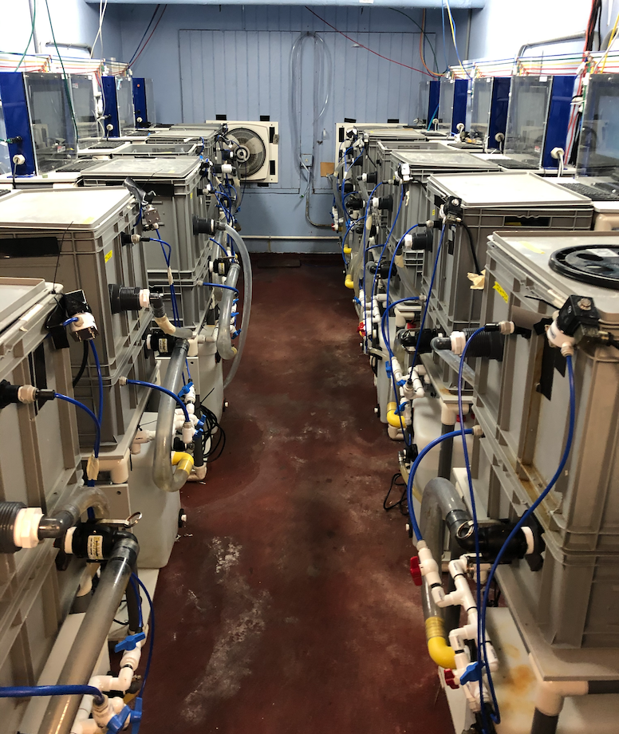

Slide 16
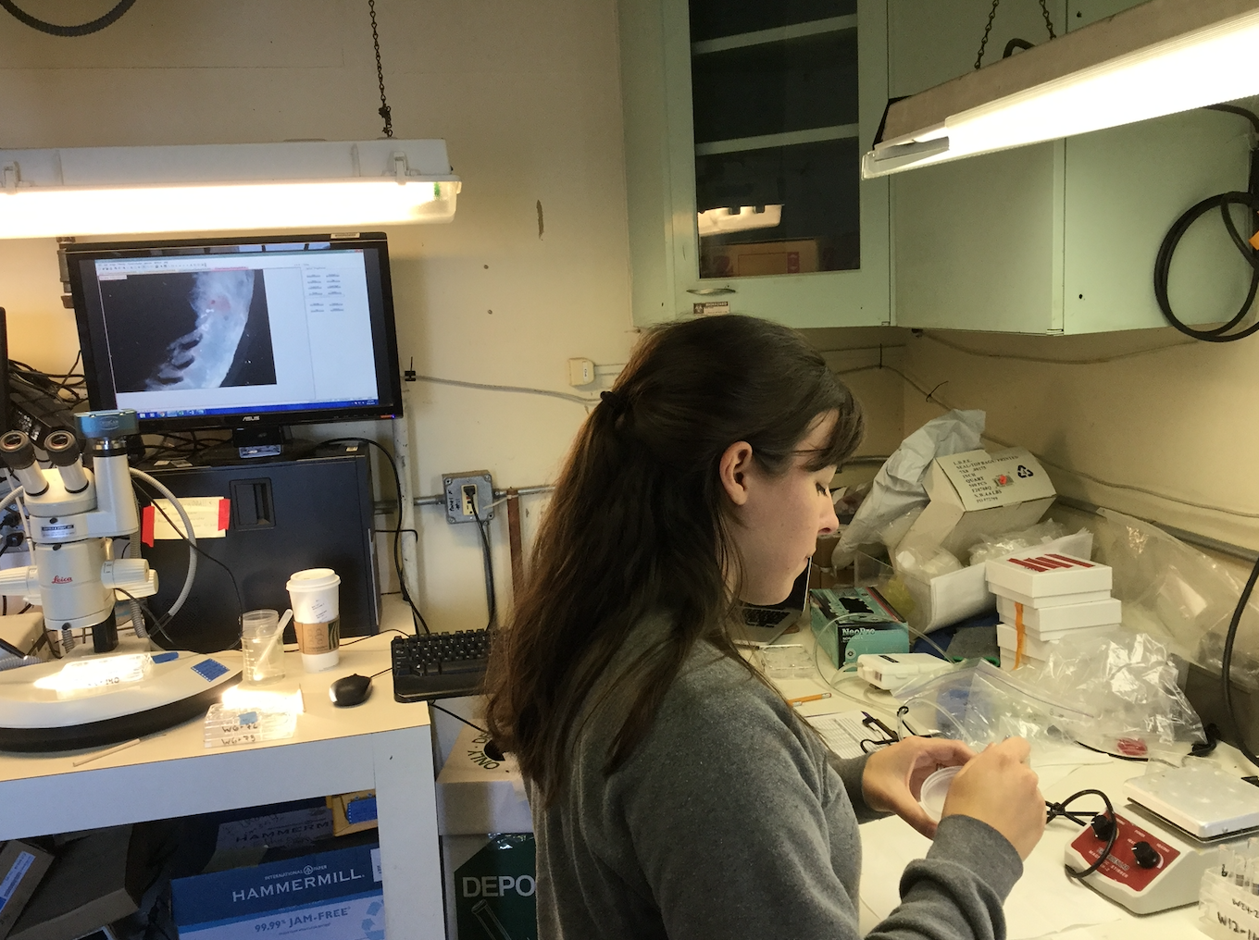

Slide 17
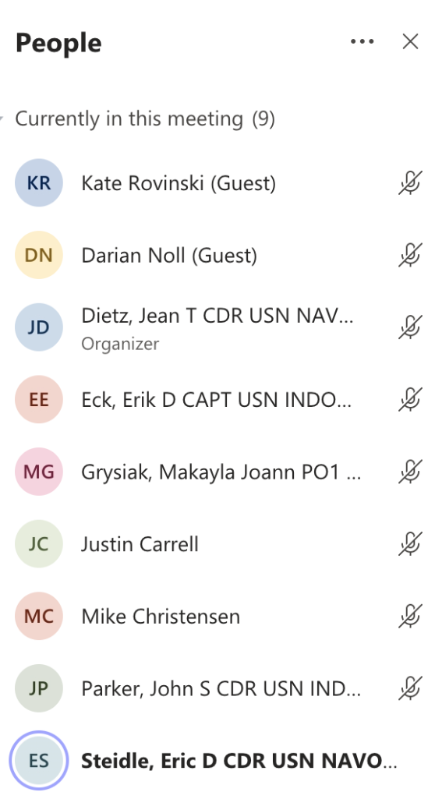

Notes:
Teresa Quinn 425-339-5268, tquinn@snohd.org

